Slide 1
Working with Devices

Slide 2
Agenda
1
Introduction to Perfecto
2
Device Operation
3
Perfecto features
4
Perfecto Reporting

Slide 3
Introduction to Perfecto

Slide 4
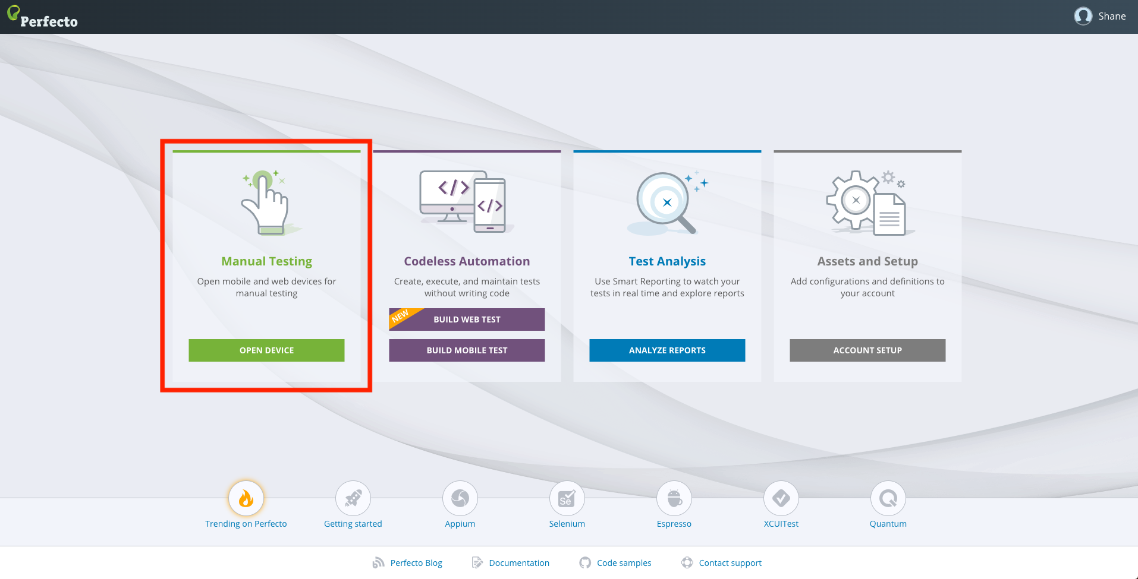
introduction to Perfecto
Manual Testing
This section provides information on anything related to the Manual Testing view (formerly known as Mobile Interactive), such as device selection and operation, including widgets and productivity features available when working with a device. Up to 3 device sessions can run in parallel.
Engagement Review
Introduction to Perfecto
Notes:
Case w/ Asaf

Slide 5
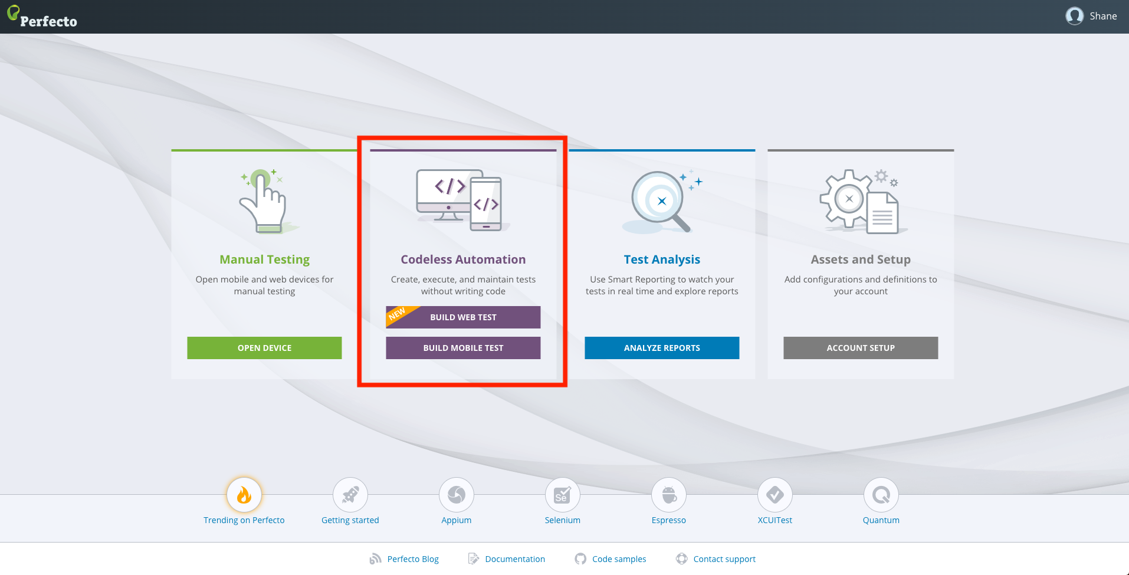
introduction to Perfecto
Codeless Automation
Perfecto Codeless is the creation of AI-driven test automation that is based on Selenium. You can use it to complement Selenium or to replace Selenium for test creation. Codeless enables all team members to quickly create stable test automation without needing to code and without having to spend time on maintenance, due to self-healing AI.
Engagement Review
Introduction to Perfecto
Notes:
Case w/ Asaf

Slide 6
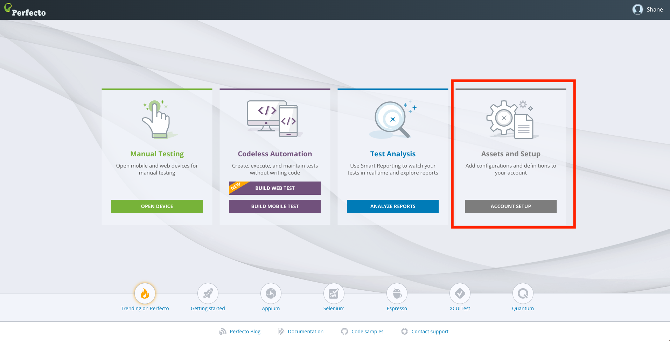
introduction to Perfecto
Assets and Setup
Assets and Setup allows custom failure reasons to be edited for administration purposes. Users can add custom failure reasons to add clarity and to simplify report viewing. New failure reason filtering allows quicker and easier access to "Why did my executions failed?"
Engagement Review
Introduction to Perfecto
Notes:
Case w/ Asaf

Slide 7
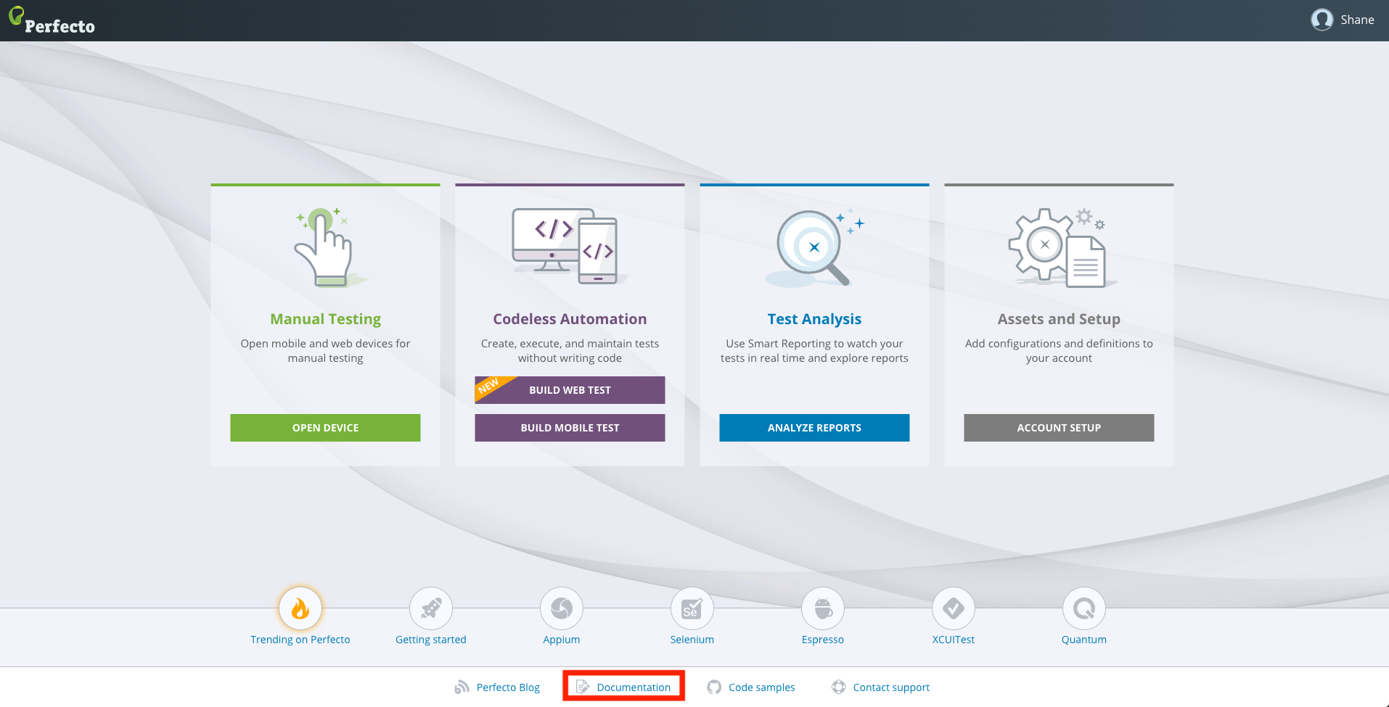
introduction to Perfecto
Documentation
Perfecto Documentation Portal holds information you may need to start your journey with Perfecto.
Training Materials
Code Samples
Documentation
Engagement Review
Introduction to Perfecto
Notes:
Case w/ Asaf

Slide 8
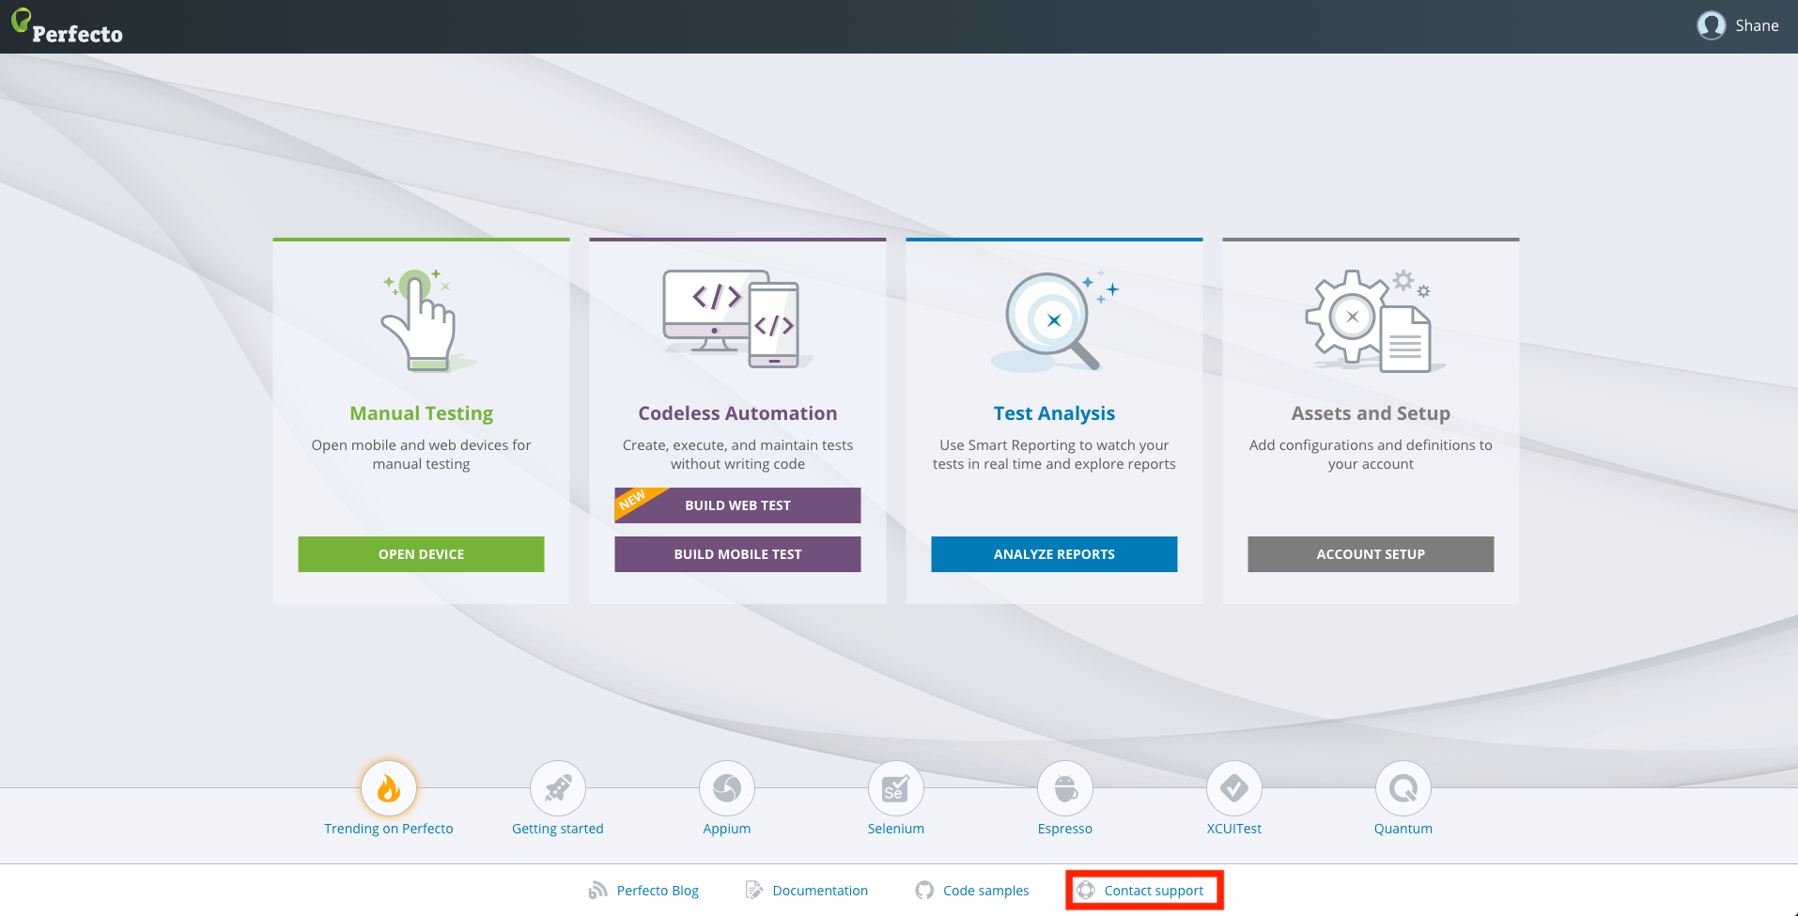
introduction to Perfecto
Contact Support
When you run into an issue or have a question, there is a resource to assist you! There are multiple ways to work with the Perfecto Support Team.
Web Portal – The web portal (support.perfecto.io) is the main channel to use when opening support tickets
Chat – There is a chat feature that is accessible from the Web Portal.
Customer Portal - We also have a Portal that resides in our CRM specifically designed for customers
Engagement Review
Introduction to Perfecto
Notes:
Case w/ Asaf

Slide 9
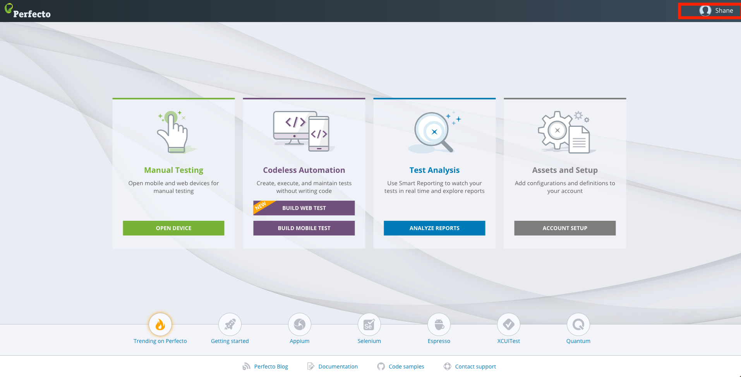
introduction to Perfecto
Account Settings
Secutity token - To enhance the security of the traffic between automation scripts and the Perfecto Lab, Perfecto has instituted the use of a security token used by the different automation tools when activating the Perfecto Lab system. The security token is a unique cryptographic key assigned to an authorized user.
Change Password – Change your perfecto password
Engagement Review
Introduction to Perfecto
Notes:
Case w/ Asaf

Slide 10
Device Operations

Slide 11
Device Operations
Selecting Devices
Engagement Review
Engagement Review
Introduction to Perfecto
Notes:
Case w/ Asaf

Slide 12
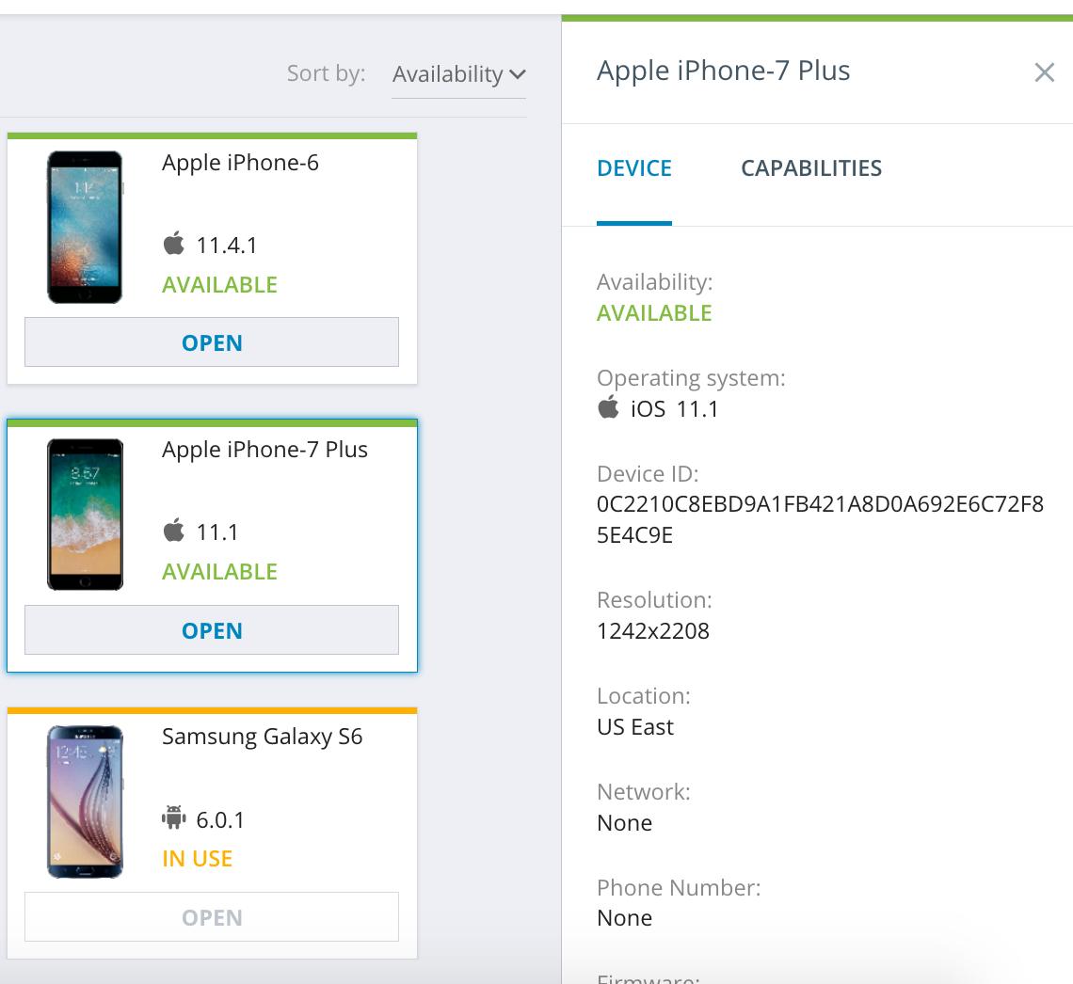
Device Operations
Selecting Devices Continued
Devices can be view by OS or type (Mobile, Web)
The Recent devices group shows all the latest devices that were used.
For Each device a detailed view provides all properties & capabilities
Engagement Review
Engagement Review
Introduction to Perfecto
Notes:
Case w/ Asaf

Slide 13
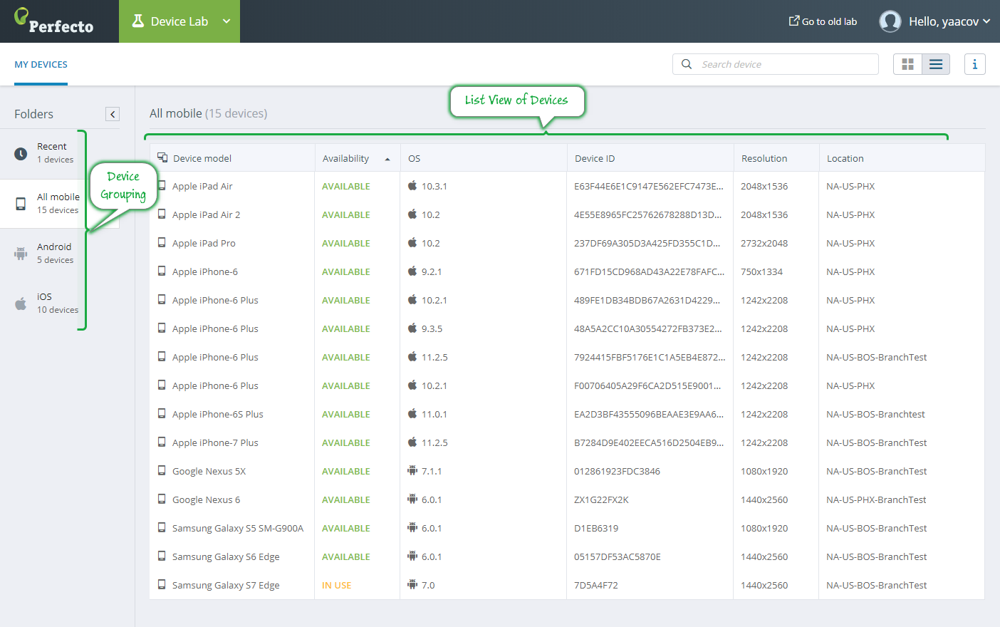
Device Operations
List View & Search
The list view shows a simple list of devices with status.
The search box allows typing in the device required.
Engagement Review
Engagement Review
Introduction to Perfecto
Notes:
Case w/ Asaf

Slide 14
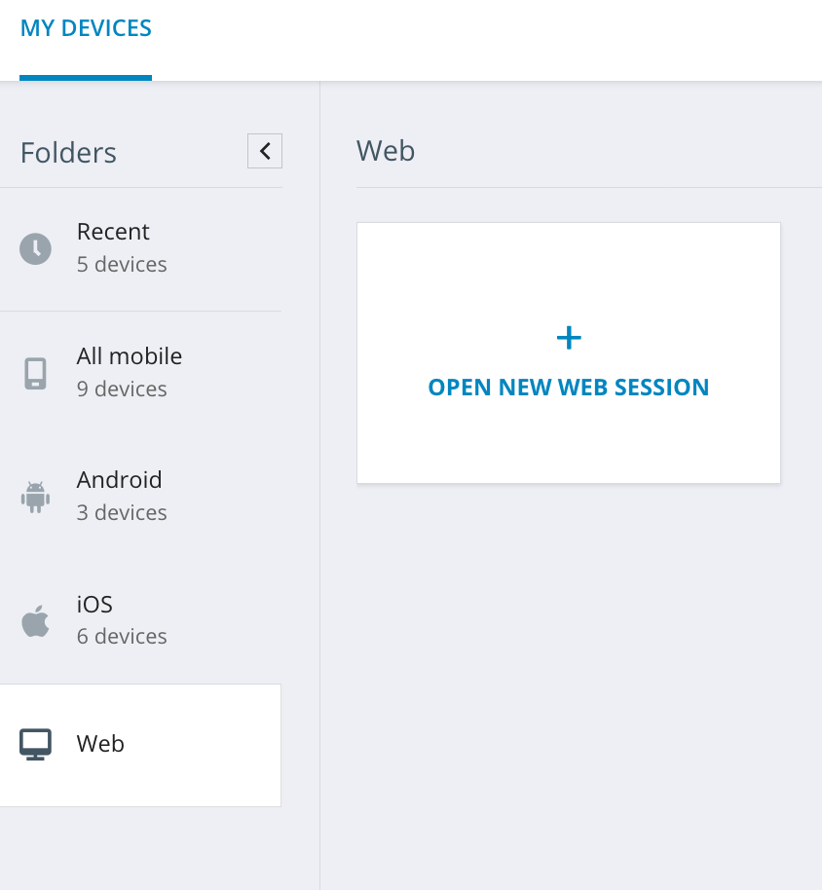
Device Operations
Selecting Web Devices
Web instances are created on the fly
Click on Web from the folder list and then open a new web session.
Select the instance type
OS
Resolution
Region
Browser
Browser Version
Copy Capabilities or Launch
Engagement Review
Engagement Review
Introduction to Perfecto
Notes:
Case w/ Asaf

Slide 15
Device Operations
Web Selection
Engagement Review
Engagement Review
Introduction to Perfecto
Notes:
Case w/ Asaf

Slide 16
Device Operations
Selecting Devices Continued
Devices can be view by OS or type (Mobile, Web)
The Recent devices group shows all the latest devices that were used.
For Each device a detailed view provides all properties & capabilities
Engagement Review
Engagement Review
Introduction to Perfecto
Notes:
Case w/ Asaf

Slide 17
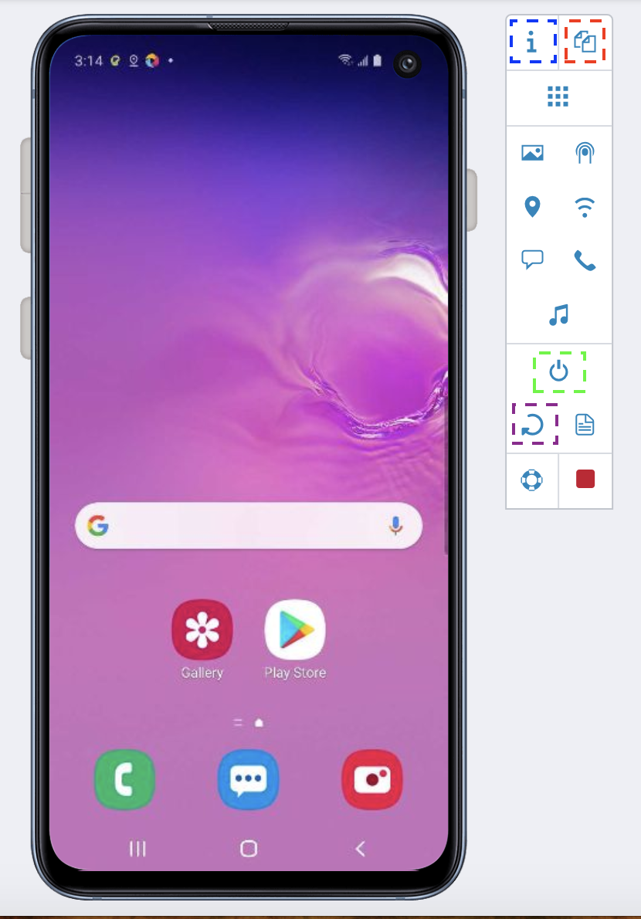
Perfecto Functions
Mouse Actions
Mouse Action | Command Description | Supported OS
Alt+Wheel forward | Zooms in | Android, iOS
Alt+Wheel backward | Zooms out (pinch) | Android, iOS
Wheel forward/backward | Scrolls | Android, iOS
Click+Pointer move | Swipes (horizontal/vertical) | Android, iOS
Left click | Taps | Android, iOS
Long left click (> 2 seconds) | Presses long | Android, iOS
Alt+Click | Activates 3D Touch | iOS
Engagement Review
Engagement Review
Introduction to Perfecto
Notes:
Case w/ Asaf

Slide 18
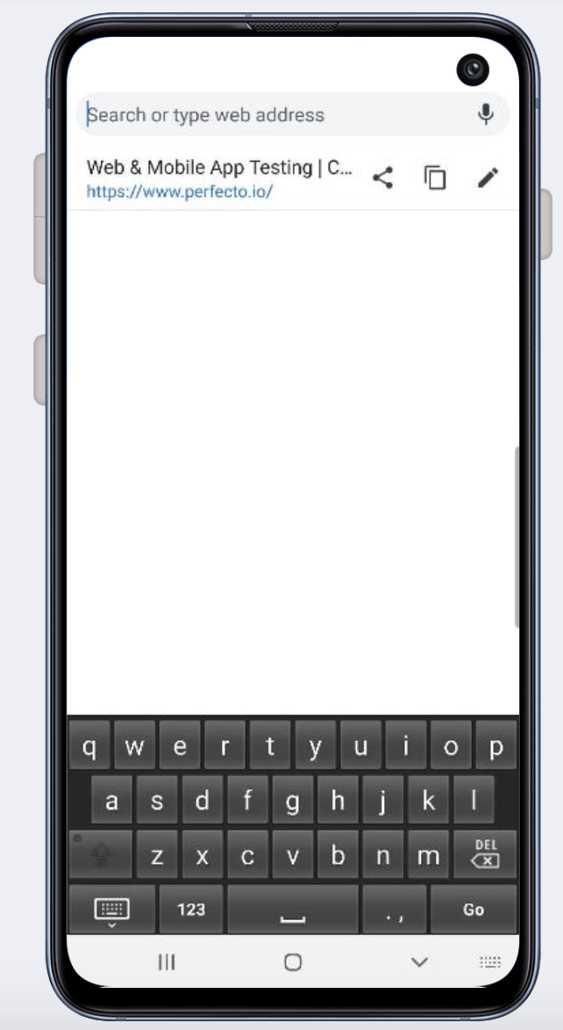
Device Operations
Key Features
To use Text Entry mode
The device should be in text-entry mode
This means that either:
The virtual keyboard is open
Or the cursor is waiting for text
In most devices, text enter can be completed in any language supported by the device. The Text is sent directly to the operating system, disregarding the Virtual Keyboard.
Engagement Review
Engagement Review
Introduction to Perfecto
Notes:
This needs to be looked at I am not sure how we should frame this

Slide 19
Perfecto Features

Slide 20
Perfecto Functions
Device Widgets
Click to retrieve device information, including OS, device ID, location, and so on, and generate capabilities.
Click to copy the session ID. See also Share a device session with an IDE script and Share a desktop web session with an IDE script.
Click to rotate the device from portrait to landscape and vice versa.
Click to restart the device, for example when the device freezes or for a fresh start.
Engagement Review
Engagement Review
Introduction to Perfecto
Notes:
Case w/ Asaf

Slide 21
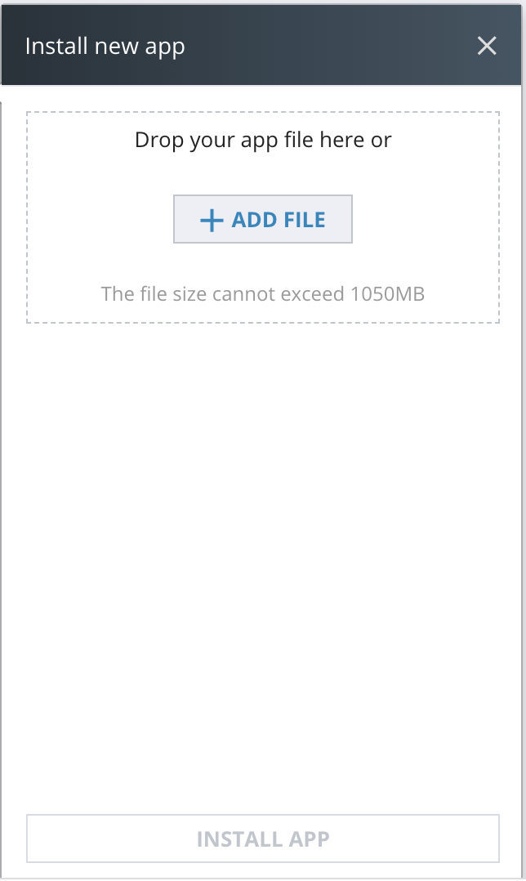
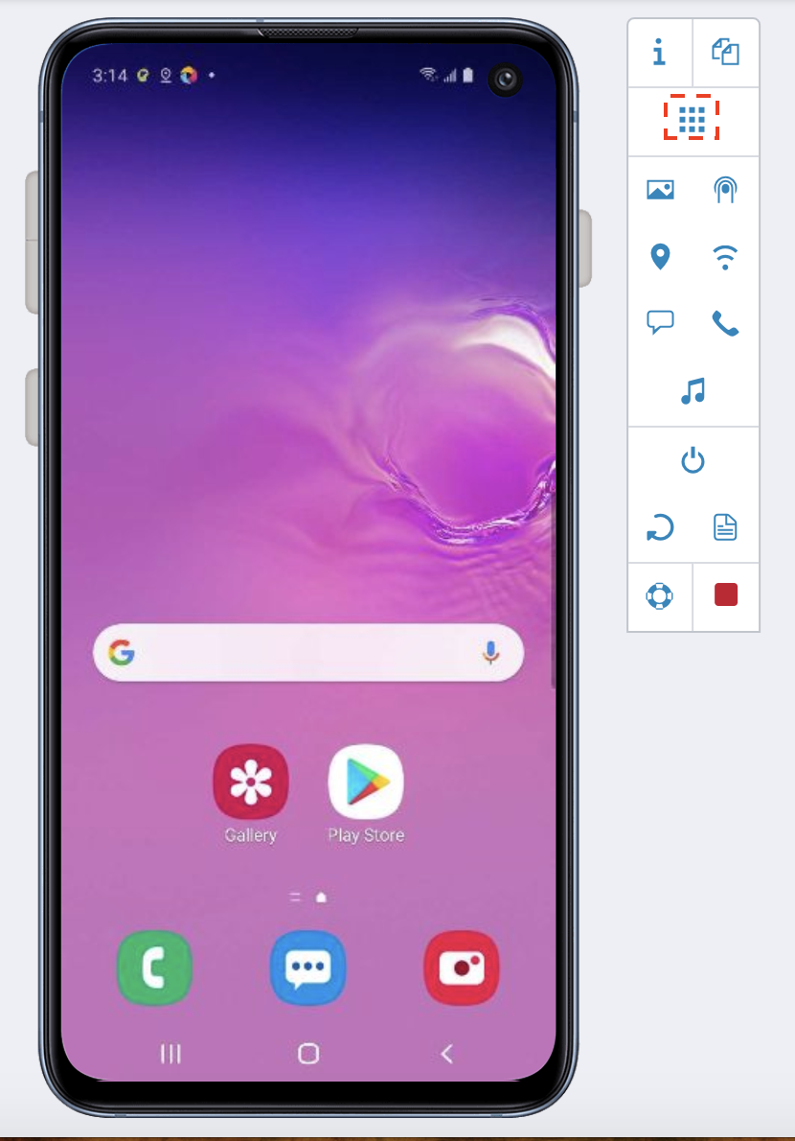
Perfecto Functions
Applications
Engagement Review
Engagement Review
Introduction to Perfecto
Notes:
To install an application on an open device:
On the device toolbar, click the applications icon .
In the Applications form, click INSTALL NEW.
In the Install new app form, do the following:
Click ADD FILE. The file size cannot exceed 1050 MB.
In the Open form, browse to the application file you want to install and select it.
Click Open.
When the app is ready to install, turn on any of the following options, as required:
Sensor instrumentation On iOS, this options also include resigning the application.
WebView instrumentation On iOS, this option also includes resigning the application.
Resign application (iOS ony) If you have selected any of the other two option, this option becomes unavailable.
If you want the app to start when the installation is complete, select the Launch after installing checkbox.
Click INSTAL APP. Perfecto installs the application and launches it (if you selected this option).
To run, stop, or delete an app:
On the device toolbar, click the applications{icon .
In the Applications form, move the pointer over the required application.
Click one of the following icons:
to run the app
to stop the app
to delete the app
Find an app
If the open device has many applications installed, the one app you are looking for may be hard to find. You have these options:
Toggle the Hide default apps option. This option is by default turned on so that all system applications are hidden. If the app you are looking for is defined as a default app, you need to turn this option off.
Use the Search field. The search results update as you type.

Slide 22
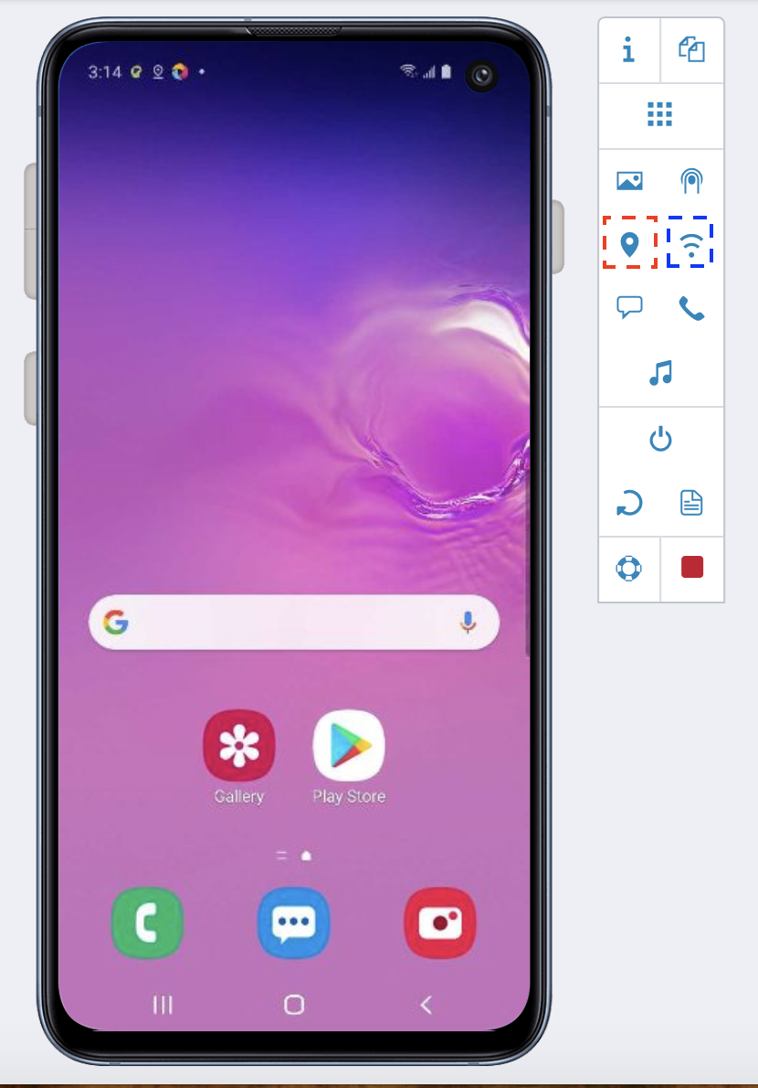
Perfecto Functions
Network Controls
On an open device, if you test a location-aware app that uses Location Services to generate location data, you can set a location without moving the device from place to place. As a location, Perfecto accepts an address (full or partial) or a pair of latitude and longitude coordinates.
On an open device, you can simulate application behavior in different network environments by initiating network virtualization. Perfecto offers a list of preset network conditions, or profiles, but you can also customize the conditions to match your requirements. For each available profile, the list shows the values for the following parameters, in this order:
Network constant to use, which is the string constant representing the network profile
Latency (ms)
Bandwidth in/out (Kbps)
Packet loss (%)
Engagement Review
Introduction to Perfecto
Notes:
For devices that have a SIM card installed, you can simulate everyday situations while an application is running, including an incoming call. This allows you to test how a device responds to such runtime events.
For devices that have a SIM card installed, you can simulate everyday situations while an application is running, including an incoming SMS. This allows you to test how a device responds to such runtime events.

Slide 23
Perfecto Functions
Cloud Services
To initiate a call to the open device:
On the device toolbar, click the Call Me icon
When the call comes in, accept or reject it as needed for testing.
Engagement Review
To initiate an SMS to the open device:
On the device toolbar, click the SMS Me icon.
When the message comes in, open it with the phone's text messaging app, if needed.
Introduction to Perfecto
Notes:
For devices that have a SIM card installed, you can simulate everyday situations while an application is running, including an incoming call. This allows you to test how a device responds to such runtime events.
For devices that have a SIM card installed, you can simulate everyday situations while an application is running, including an incoming SMS. This allows you to test how a device responds to such runtime events.

Slide 24
Perfecto Functions
Image Injection
On an open device, you can inject an image to mock the use of the camera. This is helpful for testing application actions, such as focus or image placement, in apps that rely on camera usage, for example barcode readers or bank check scanning apps. Image injection supports uploaded images in .jpeg, .jpg, .png, or .bmp format. The file size cannot exceed 150 MB.
For image injection to work, the application to test must have been installed with sensor instrumentation enabled. In addition, the app needs to stay in the foreground.
Engagement Review
Introduction to Perfecto
Notes:
To inject an image:
On the open device, start the application you want to test and activate the camera. Make sure the app stays in the foreground.
In the device toolbar, click the image icon .
In the Inject image form, click ADD IMAGE and browse to the image file you want to use for testing.
When the file has loaded, click INJECT IMAGE. The image should display in the app.
Perform the required testing.
When done, click the image icon again and stop the injection.

Slide 25
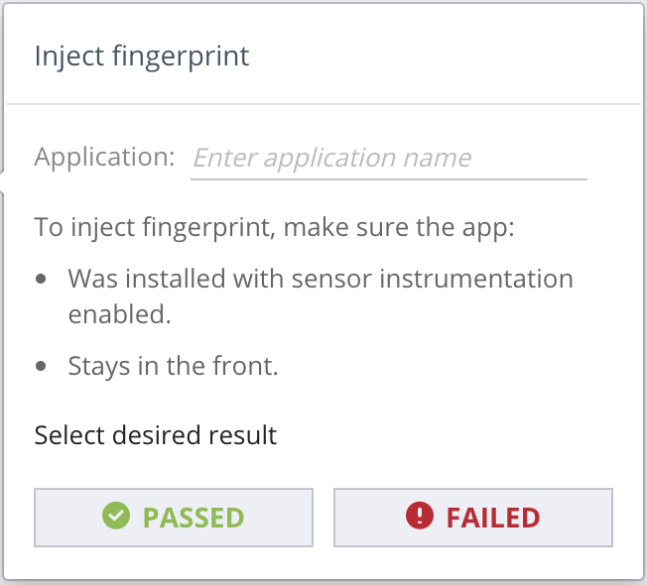
Perfecto Functions
Biometric Sensor
On an open device, you can inject a passing or failing fingerprint or face ID, depending on the device model. Face ID is available on iPhone X and later.
For this option to work as expected, the app to be tested must have been installed with sensor instrumentation enabled and stay in the front during testing.
Engagement Review
Introduction to Perfecto
Notes:
To inject a fingerprint or face ID:
Open the application you want to test and make sure it stays in the foreground.
On the device toolbar, click the fingerprint icon or face ID icon .
In the Fingerprint injection or Face ID injection form, in the Application field, enter the name of the application you want to test.
Do one of the following:
To test a successful fingerprint or face ID, click Passed.
To test an invalid fingerprint or face ID, click Failed.

Slide 26
Perfecto Functions
Perfecto Widgets
On an open device, you can retrieve the last x number of lines of the device's operating log. The log includes valuable data that can help understand execution problems. By default, Perfecto retrieves 500 lines. The supported range is 1 to 1000.
Click to open a case with Perfecto Support. The link opens in the context of your open device session.
Engagement Review
On an open device, you can choose to ignore the current test or to end the session. This option also provides a link to the report in the Report Library.
Introduction to Perfecto
Notes:
To inject a fingerprint or face ID:
Open the application you want to test and make sure it stays in the foreground.
On the device toolbar, click the fingerprint icon or face ID icon .
In the Fingerprint injection or Face ID injection form, in the Application field, enter the name of the application you want to test.
Do one of the following:
To test a successful fingerprint or face ID, click Passed.
To test an invalid fingerprint or face ID, click Failed.

Slide 27
Thank You

